Slide 1
Lecture 16:
Red and Green Politics in India
Course: Environment and Politics in India

Slide 2
  “Man lives from nature, i.e. nature is man’s inorganic body, and he must maintain a continuing dialogue with it if he is not to die. To say that man’s physical and mental life is linked to nature simply means that nature is linked to itself, for man is part of nature”
  – Marx in EPM, 1844.
  “Let us not, however, flatter ourselves overmuch on account of our human conquest of nature. For each such conquest takes its revenge on us…At every step, we are reminded that we by no means rule over nature like a conqueror over a foreign people, like someone outside nature – but that we, with flesh, blood, brain, belong to nature, and exist in its midst, and that all our mastery of it consists in the fact that we have the advantage of all other beings of being able to know and correctly apply its laws”.
  - Engels

Slide 3
Man and Nature relationships
MARXIST theory:
Deep inter-relationship between humanity and nature.
Workers’ FOURFOLD alienation:
  Alienation from nature
  Alienation from products of labour
  Alienation from other people/workers
  Alienation from self
  Human societies would have to control interaction with nature. BUT this ‘rational’ control of relations between humans and nature was not the mechanistic domination of nature .
  Labour should work according to the “LAWS of NATURE”.
  Need to protect the basis of “production” of life, i.e. nature. Production is NOT merely economic production.

Slide 4
It’s quite interesting, because if you look back in history, trade unions were some of the first environmentalists. We were the first ones that made the link between the workplace and the local community. So when you look back in the industrial revolution it was the trade unions that were saying, “Hang on a minute, these rivers are polluted, and our families are getting sick.”
—Interview with a European trade unionist

Slide 5
Marx on Industrial Pollution
Karl Marx writing on “UNIVERSAL POLLUTION” to be found in industrial society:
“Even the need for fresh air ceases to be a need for the worker. Man reverts once more to living in a cave, but the cave is now polluted by the mephitic and pestilential breath of civilization. Moreover, the worker has no more than a precarious right to live in it, for it is for him an alien power that can be daily withdrawn and from which, should he fail to pay, he can be evicted at any time. He actually has to pay for this mortuary…
Light, air etc. – the simple animal cleanliness – ceases to be a need for man. Dirt – this pollution and purification of man, the sewage of civilization – becomes an element of life for him. Universal unnatural neglect, putrefied nature, becomes an element of life for him.”
—Excerpts from the Economic and Philosophical Manuscripts (EPM)

Slide 6
Labour and the Environment
Labour as the WEAKEST link in environmental solidarities?
Overarching concern for jobs, wages, bonus, working conditions.
Classic JOBS versus ENVIRONMENT debate.
Catering to workers and workers’ communities: Trade unions and Occupational Health and Safety (OHS).
OHS: Demands for more regulation, planning, expenditure related to environment/work spaces.
Where “green runs alongside red as our colour of choice”…
2006, Nairobi: 150 unions participated in an international trade union conference. Incorporation of ‘environmental’ rights as part of ‘traditional’ workers’ rights
2009/2010: Conferences in Gothenburg and Mexico City. Metalworkers unions and transport unions incorporate environmental concerns.
Conference of the Parties (COP) 15/16: Environment was too important a concern to be “left to the environmentalists”.

Slide 7
Labour and the Environment
FOUR possible discourses of trade union engagement with climate change:
Technological fix
Social transformation
Mutual interests
Social movements
These discourses MISUNDERSTAND Marx’s reading of labour and nature.
They see labour as the ONLY source of wealth and use value.
IGNORE nature as an equal and crucial source of use value.
BUT, attempt to break the distinction between workers in the workplace and citizens outside the workplace, reinventing unions as social movements.

Slide 8
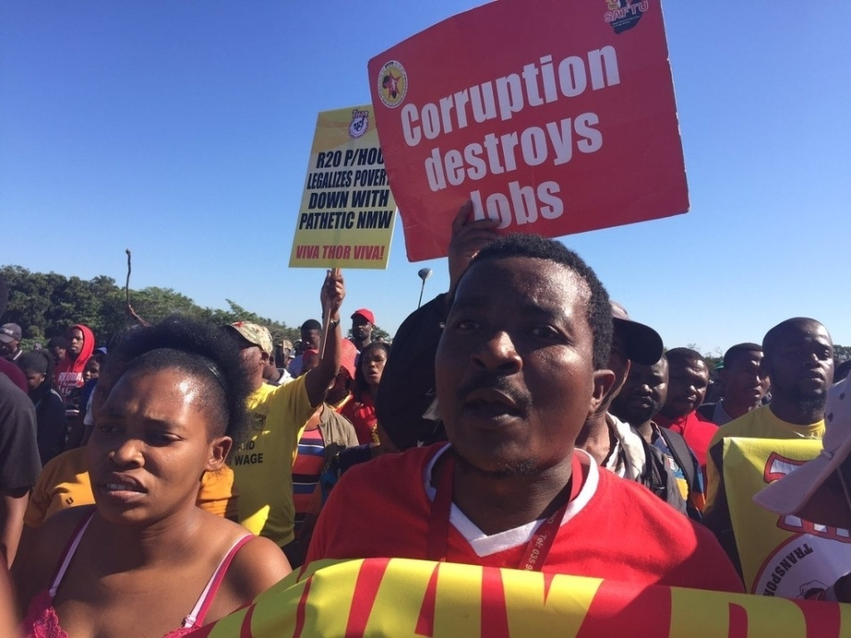

Labour and the Environment
EXAMPLES:
National Union of Metalworkers of South Africa (NUMSA):
Contested electricity price increases
Demanded the roll-out of solar water heaters
Sought to bring the demand of socially-owned renewable energy to the forefront of discourse.

Slide 9
Social Movement Unionism
Emerged in the 1970s and the 1980s.
WHERE: Global South. South Africa, Brazil, Korea, Philippines.
HOW: Rejection of the ‘economistic’ vision. Alternative vision for trade unions. Building bridges with OTHER social movements for transformation.
Modus Operandi? Engages equally with the factory/mine “workspace” and the larger community where workers reside.
Not MERELY a “shift” of working area or of mass bases. A more FUNDAMENTAL philosophical shift of “labour” as a category. It seeks to redefine the meaning of labour, expanding the concept to include ALL working people.
Trade unions LEAD ALL movements in their areas, dealing with ANY issue concerning workers and their families. E.g. Housing, health care, education, transport, running water.
TARGET: Not ONLY industrial managements, BUT ALSO local state machinery/government.

Slide 10
Ideological Dilemmas in Indian Environmentalism
Anil Agarwal: “Indian environmentalism needs to move beyond pretty trees and tigers…”
“Western” models of environmentalism (wilderness protection, rapid industrialization tempered with regulation etc.) would NOT work in India.
India: ‘Poor’ were not MERELY ‘allies’ of the environmental movements. Landless peasants, adivasis, nomads, fisherpeople would DRIVE Indian environmentalism. WHY?
Guha and Martinez Alier: “Environmentalism of the Poor” originating in “social conflicts over access to control over natural resources”
ECOLOGICAL DEGRADATION and SOCIAL INJUSTICE as two sides of the SAME coin. Environmentalism as an expression of SOCIALISM.
ARE things that simple in India?

Slide 11
Ideological Dilemmas in Indian Environmentalism
TENSIONS between environmentalists and the ‘LEFT’:
Environmental movement’s position: Opposition between ‘traditional’ and ‘modern’ systems.
Environmental conservation LINKED with “traditional rights and institutions”; traditional structures of authority.
LEFT had a HUGE problem with the valorization of ‘tradition’.
LEFT supported the idea of modern science and technology and a “strong industrial and agrarian base”.
“Indian environmentalism has always been suspect in the eyes of the organised Indian left which, by and large, still subscribes to the notion that the development of capital-intensive technologies is a progressive trend”
- Amita Baviskar

Slide 12
Indian trade unions and the environment
Maharashtra Girni Kamgar Union (MGKU). 2-year long strike in Mumbai. Bonus, working conditions, pollution, mechanization.
Kerala Fisherworkers’ Unions
KIOCL controversy: Iron ore mining in the Kudremukh National Park.
WHAT did the unions say?
  Environmental concerns are ‘exaggerations’. Little adverse impact
  Jobs are more important. Demand 20-year lease for KIOCL
  Construct anti-pollutant dams, sow lands with Shola grass, change pipelines to prevent leaks
Bauxite mining in Anuppur: Environmentalists are “CIA agents” and “pro-imperialist” forces.
Grasim Rayon company in Kerala. Jobs versus Environment?

Slide 13
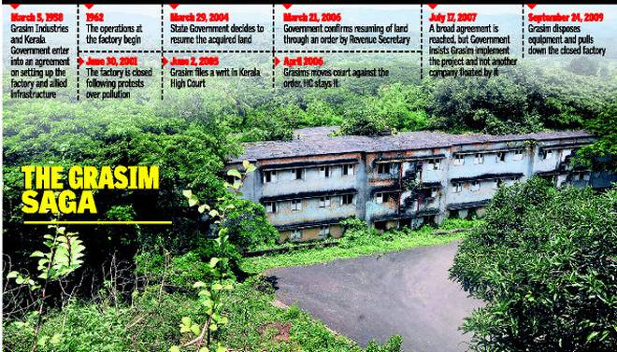
Indian trade unions and the environment

Slide 14
Indian trade unions and the environment
The Grasim Rayon’s Saga:
Company provided employment to 3,000 workers in the factory.
Kerala government permitted the company to fell timber from forests in Mavoor at cheap rates. Tribals versus Corporates?
Devastation to the bamboo forests.
Extensive pollution to the Chaliyar river.
Company destroyed livelihoods of an estimated 3,00,000 bamboo workers, sand miners, and fisherfolk.
Narrative of “GREEN IMPERIALISM”, Trade Union leaders doubling as spokespersons of the Company.
“Nature” against jobs and “production”; Economic rationality against ecological sustainability.

Slide 15
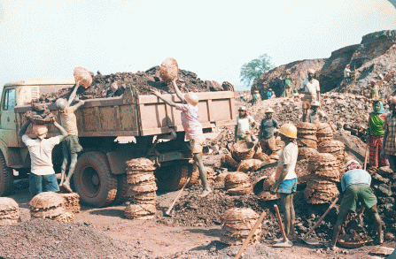
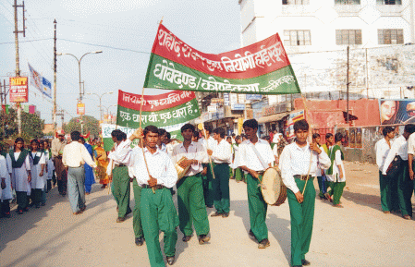
CMM and Alternative Ecological Visions
Chhattisgarh Mukti Morcha (CMM)
Formed during a battle for parity in wages.
Organized workers in mines, factories, forests.
Red AND Green flag/vision.
Moving beyond ‘economism’ of wages/bonus.

Slide 16
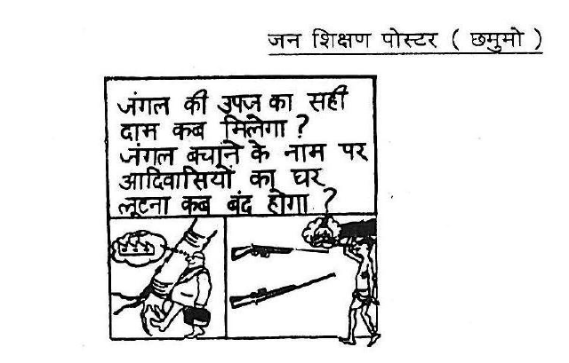
CMM and Alternative Ecological Visions

Slide 17
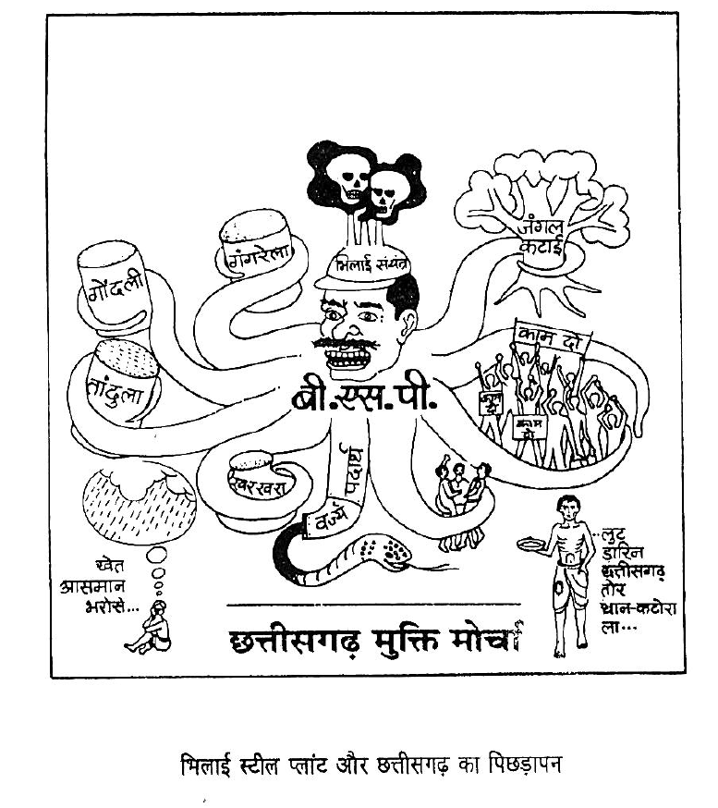

Slide 18
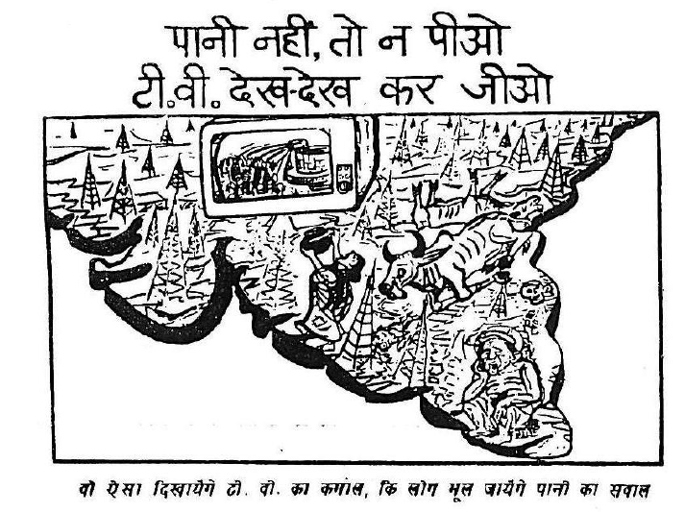
CMM and Alternative Ecological Visions

Slide 19
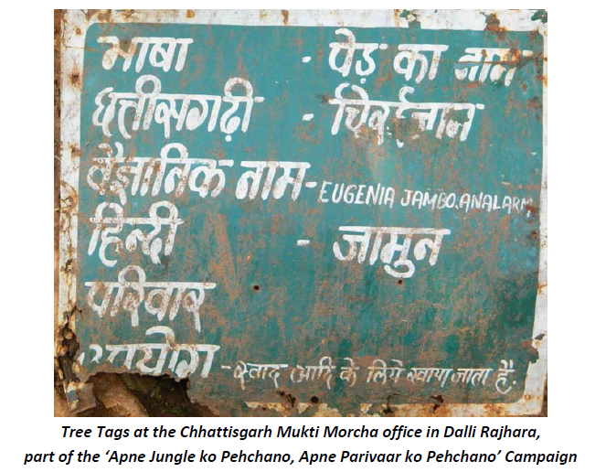
CMM and Alternative Ecological Visions
CMM’s ISSUES:
Against Industrial Pollution
Against captive plantations and monocultures
Paryavaran Thanas
Afforestation
Against massive water extraction by industry
Big Dams. Alternative water management model.
Against Green Revolution

Slide 20
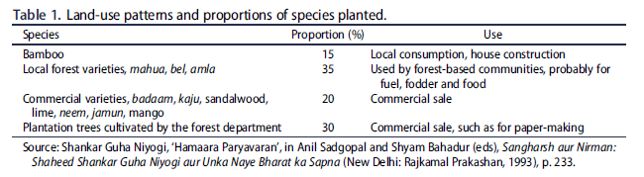
CMM and Alternative Ecological Visions

Slide 21
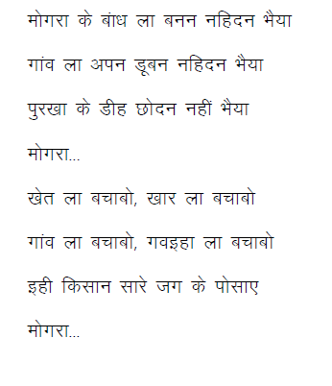

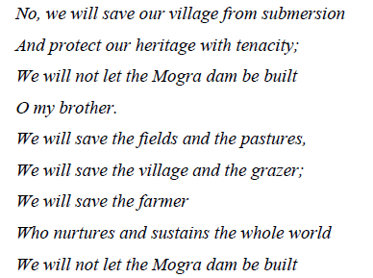
CMM and Alternative Ecological Visions

Slide 22
